Slide 1

LIFE ON THE MOVE What Makes a Great Community Transport Service & How We Can All Help
By Rachael Leahcar
ACTA National Conference

Slide 2
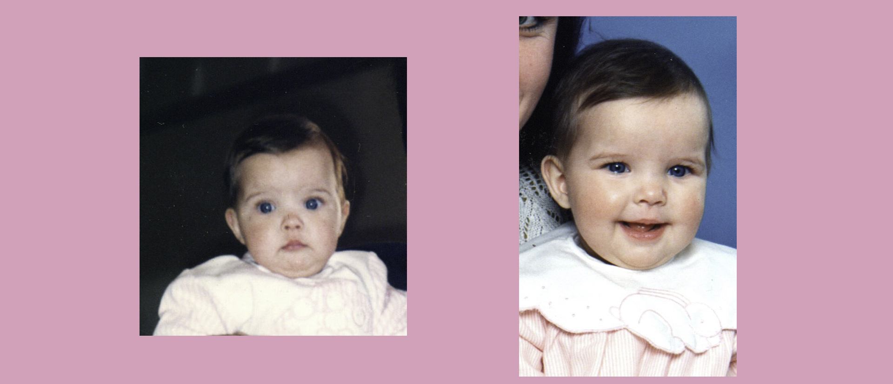
Inspiration & Upbringing
Born with Retinitis Pigmentosa (RP) – degenerative genetic eye condition
Vision decreased from 50% at birth to 2-5% today
Early passions: sports & music
Music became a strength — connection through sound

Slide 3

Teen Years & Independence
First cane use = self-conscious → became proud of it
Cane = tool for safety & independence
Early public transport challenge: got lost after unclear driver communication
Now: apps like Google Maps, Blindsquare, Lazarillo assist navigation
"When it works, it empowers. When it fails, it isolates."

Slide 4
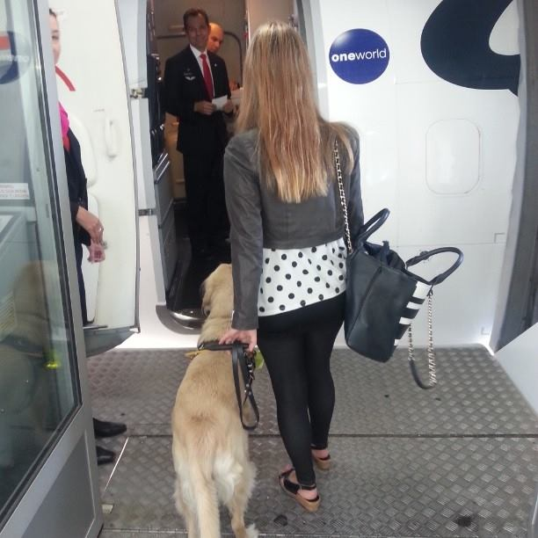
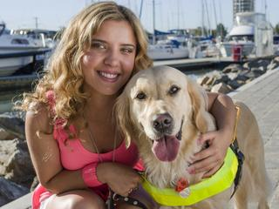
Dog Guide: Ella
Cane limitations → applied for dog guide
Ella = partner in independence
Saved me from a cliff during a walk
Travelled nationwide during Colours of My Life tour
Retired at 10 → lived happily at home until passing this year

Slide 5
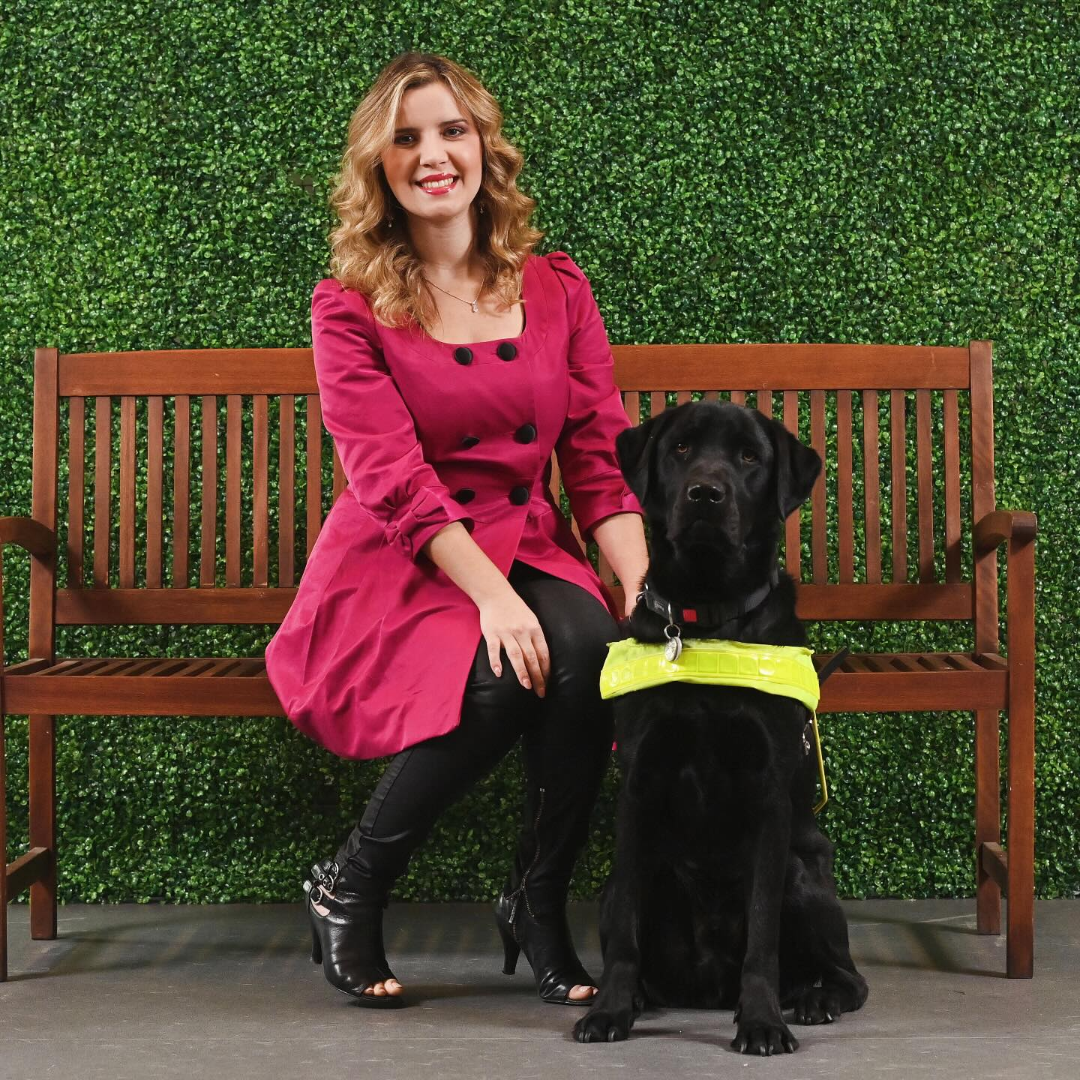
Dog Guide: Jarvis
Current dog guide: Jarvis — intuitive, loyal
“Find home” moment proved trust & teamwork
Challenges: taxi refusals, café denials, access discrimination
Assistance dogs protected by law — education still needed

Slide 6
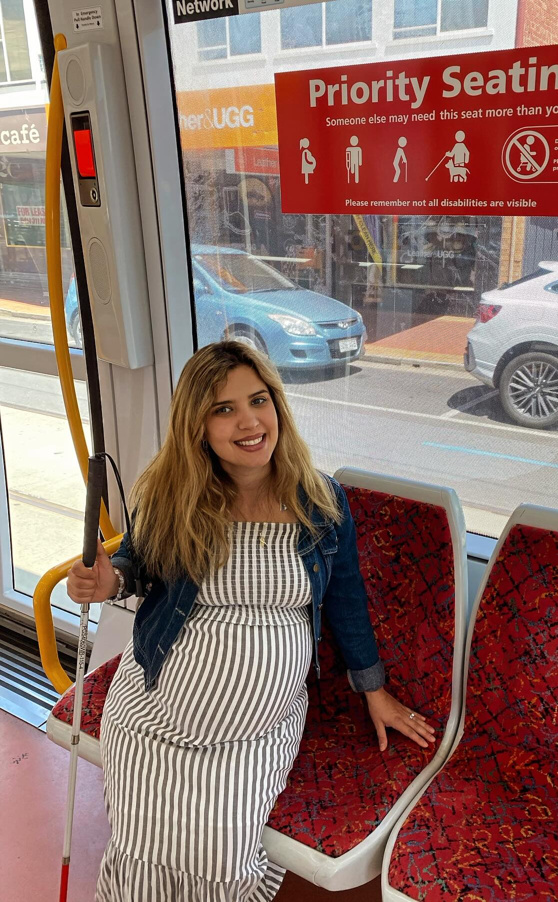
Everyday Experiences of Transport
12+ years of transport experiences: including autonomous bus trial
Positive: respectful, patient drivers
Negative: refusals, unsafe situations, lack of training
Safer Me, Safer You: sexual & social safety focus

Slide 7

What Makes a Great Service?
Safety – physical, emotional, psychological
Respect – time, access needs, autonomy
Empowerment – more independence after using service
Training + empathy
Flexibility
Consistency + reliability
Affordability
Co-design with lived experience

Slide 8

How We Can All Help
LISTEN
Listen to lived experience
EMBED
Embed safety at every level
INVEST
Invest in disability-led training
ADVOCATE
Advocate for funding & flexibility
LEAD
Lead with kindness

Slide 9

The Road Ahead
Self-driving shuttles with tailored audio navigation
Booking systems that talk & listen
Sensory-friendly alerts for drivers
Real-time route updates compatible with screen readers
Transport hubs as inclusion spaces
Imagine a world where no one is left behind because of how they move.

Slide 10
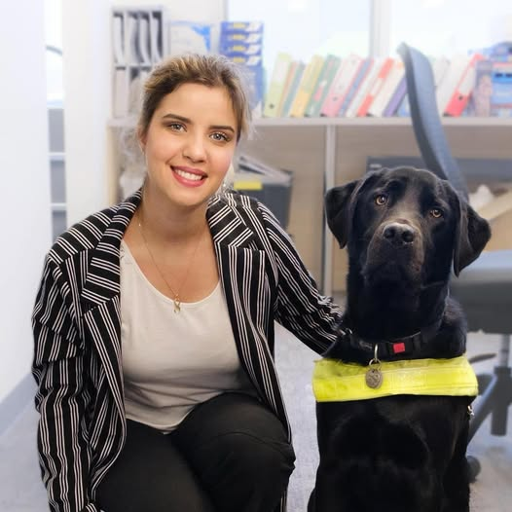
Personal Reflection
Speaking from lived experience
Transport = freedom, but failures make you feel small
We can build better, together
Life on the move should be full of possibility for everyone
"Together, we can make sure life on the move is full of possibility for everyone."

