Slide 1


Slide 2

ACTA CEO Update –
2025 National Community Transport Conference

Slide 3
Your Feedback
62 pages of information
220 ideas

Slide 4
What are the key issues that make your job harder?
Workforce & Volunteers
Funding & Financial Sustainability
Compliance, Policy & Government Relations
Demand vs Supply
Organisational & Strategic Barriers
Community & Sector-Level Issues

Slide 5
What are your pain points?
Workforce & Volunteers
Funding & Financial Sustainability
Compliance, Policy & Red Tape
Organisational & Strategic Barriers
Vehicles
Technology & Systems
Client & Community Expectations
Sector-Level & External Pressures

Slide 6
Solutions
1
Secure sustainable funding – long-term, consistent, and equitable.
2
Strengthen governance – clear accountability and national coordination.
3
Empower workforce & volunteers – recruit, retain, and streamline training.
4
Leverage technology & innovation – smarter systems, AI, and modern fleets.
Build collaboration & awareness – unify services and amplify the value of community transport.
5

Slide 7
Top 10 Priorities
Develop a sustainable funding model – 7 mentions
Clarity around funding models – 4 mentions
Advocacy as a group / one voice to influence government & funders – 3 mentions
Improve cash flow & financial sustainability – 3 mentions
Improve volunteer model / incentives / engagement – 2 mentions
Recruitment & employment focus – 2 mentions
Build stronger community transport network – 2 mentions
Stabilise and grow organisations – 2 mentions
Increase fleet size – 2 mentions
Increase case load – 2 mentions

Slide 8
The solution required more than one piece of work.
UniSA Final Report
Pilot Case Studies
Pricing and Policy Arrangements Guide
Summary Report
(Key Advocacy Focus)
Sector Readiness Assessment
UniSA Final Report
Independent Research Report from UniSA, this will include methodology, data analytics, findings, and recommendations adequately supported by research instruments.
Policy Advocacy Document, that will summarise the outputs of the research presented in the case studies, the key advocacy points from the pricing and policy arrangements, and the Sector Readiness Assessment.
Sector Readiness Assessment
Change Management Document that aims to assess the current landscape of community transport and the required changes to transition to the desired state for an effective pricing model implementation.
Pricing and Policy Arrangement Guide
Operational instrument designed to help organisations implement the pricing model.
Summary Report

Slide 9
Getting people home safely
Community Transport
Non specialist / nonclinical transport
Non specialist / nonclinical transport
Patient Transport
Specialist / nonclinical transport
Specialist / nonclinical transport
Clinical Transport
Ambulance
Clinical Transport

Slide 10

Enhancing Community Transport Services
Pull quote
Victorian Mapping Project Report

Slide 11
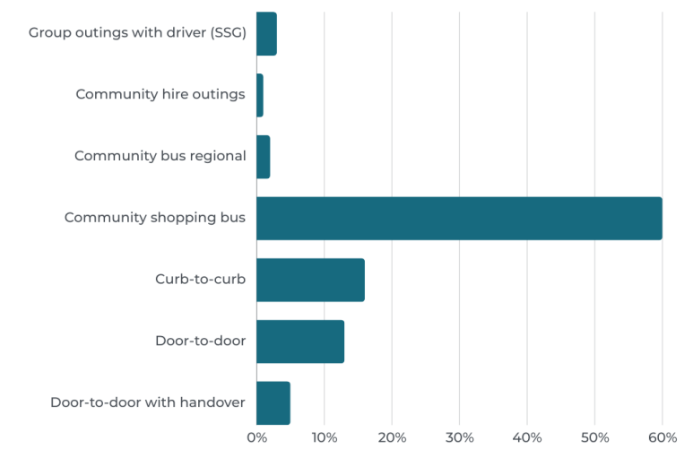
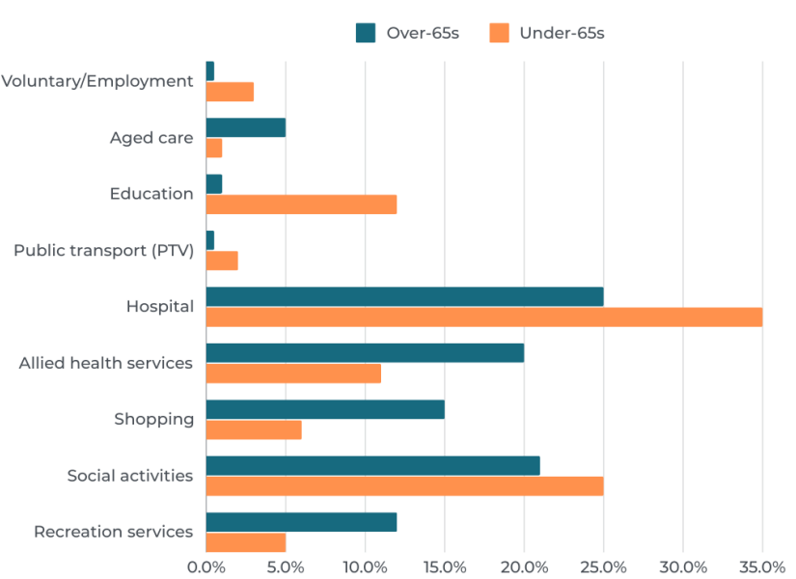
What is the purpose of community transport?
What types of services are people using?
Without community transport many Victorians would not be able to access health services, get food and stay connected.
People told us that they require the additional benefits of community transport for quality of life.

Slide 12
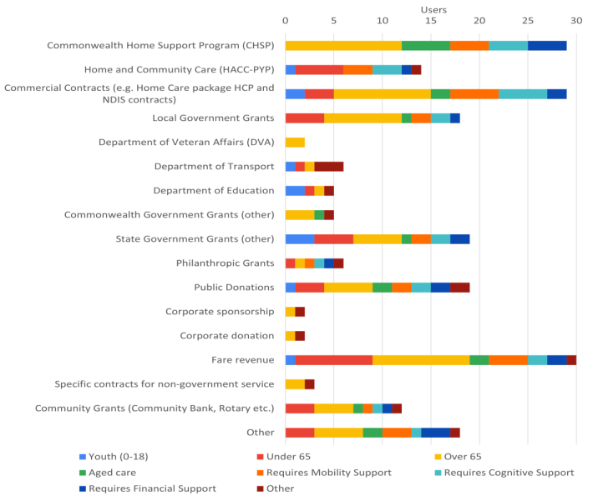

Community transport is funded through a variety of sources to address diverse needs
Victoria’s public transport network services (PTV)
Rideshare (commercial passenger vehicle)
Multi-purpose Taxi Program (MPTP)
Department of Education
Department of Veteran Affairs
Flexible Local Transport Solution (FLTSP)
Commonwealth Home Support Programme (CHSP)
My Aged Care (HCP)
Volunteer Coordinator HACC-PYP
NDIS
Non-Emergency Patient Transport (NEPT)
Ambulance

Slide 13








Working with others…
States and Territories

Slide 14


Slide 15
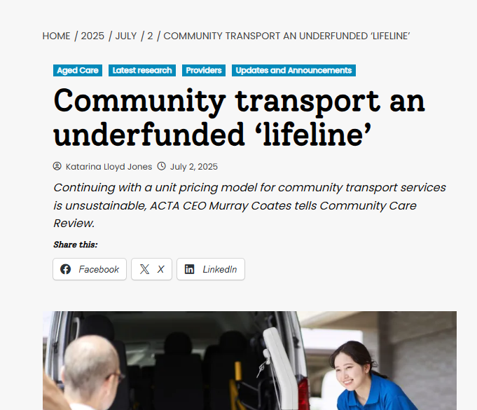
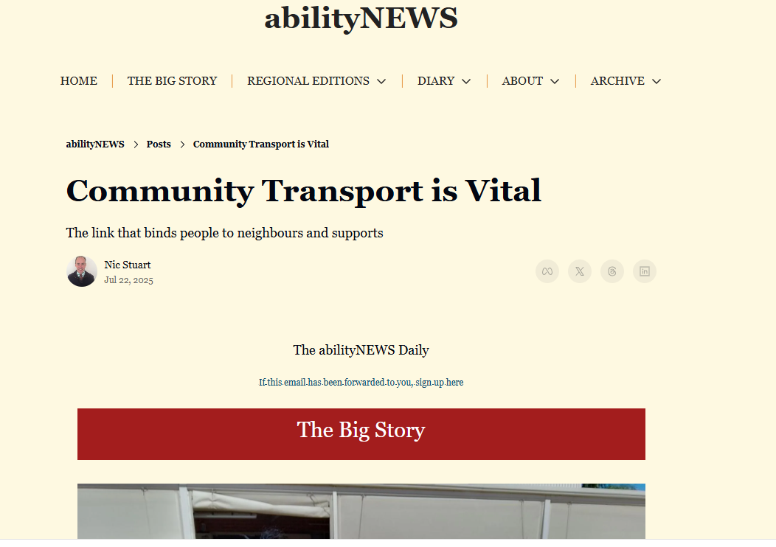

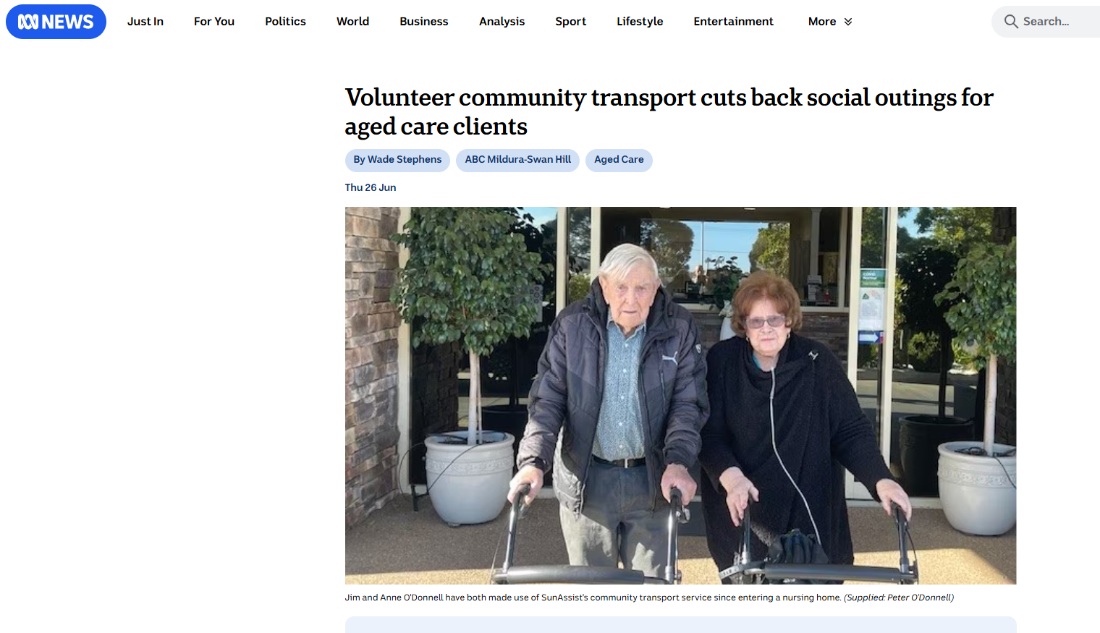
Informing the wider community and decision-makers about community transport

Slide 16
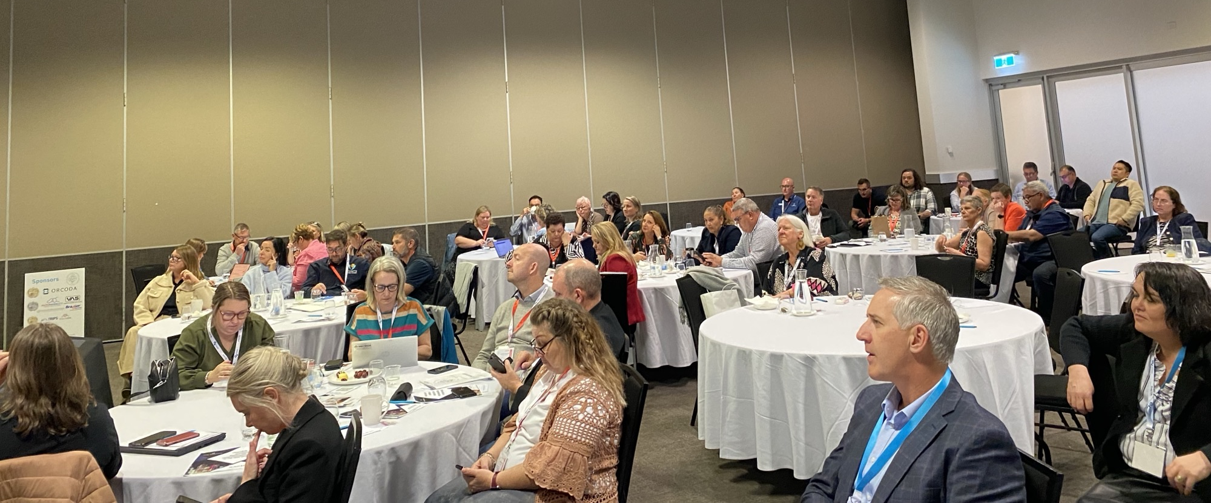
The trip over the last two days

Slide 17

CONTACT US
0447 712 049
https://communitytransportaustralia.org.au/
info@communitytransportaustralia.org.au

